Slide 1

Final MPD Presentation

Slide 2


Table of contents
Key objectives
Network Diagram
Locust
Results
Demo
Reflection
Q&A

Slide 3
Key objectives
Kubernetes Deployed Webapp
HPA Functionality
1.5 M Requests per Month
Load Balancer

Slide 4
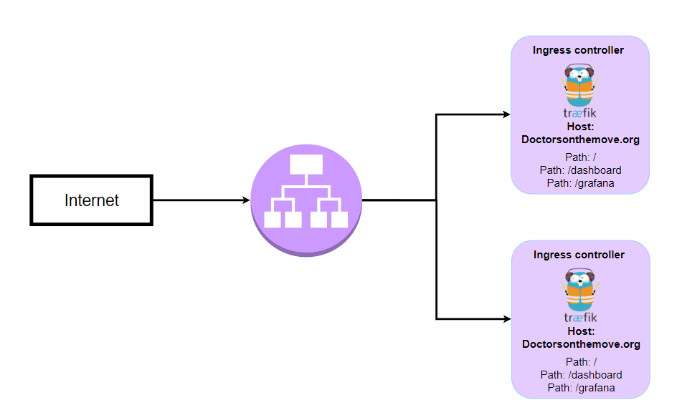

Slide 5
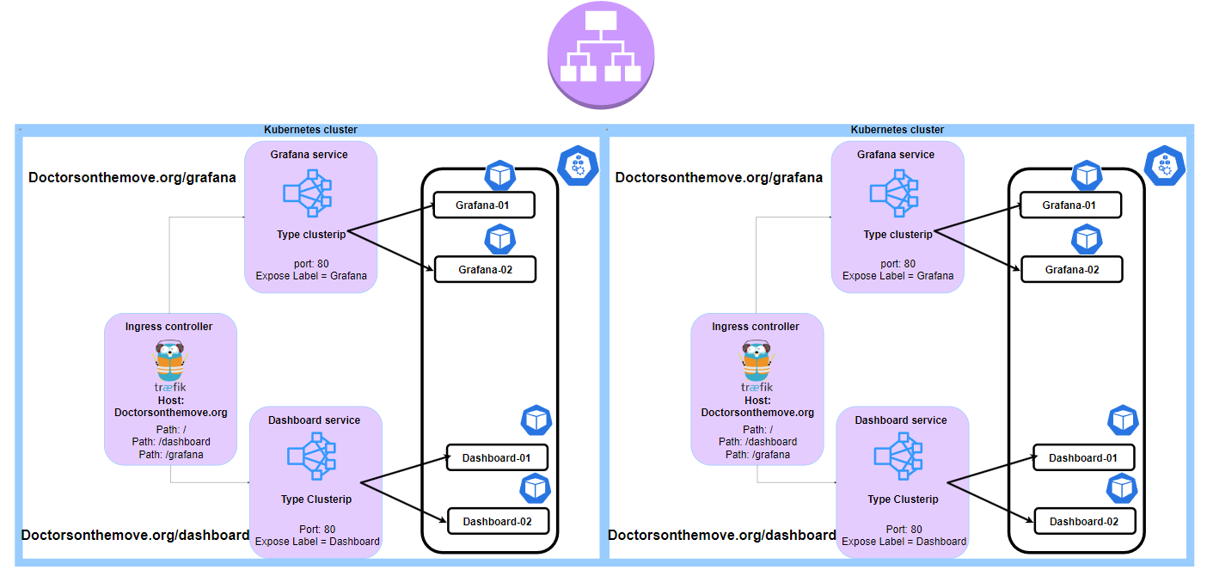

Slide 6
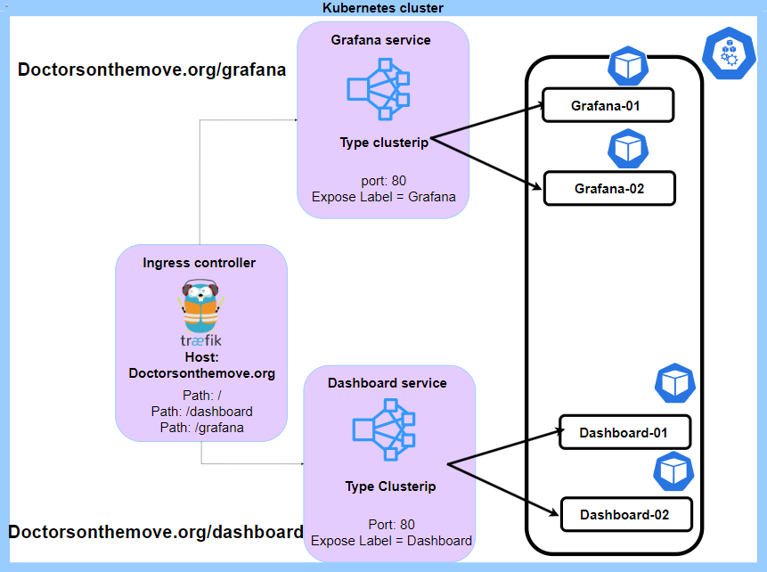

Slide 7
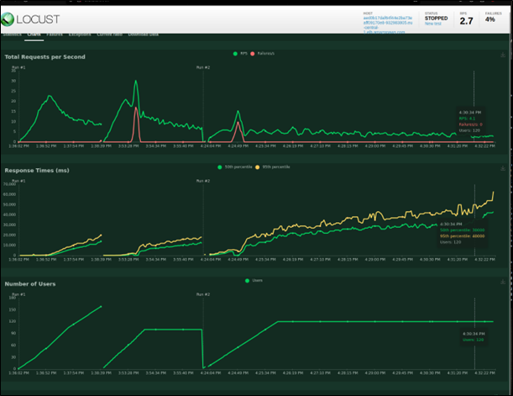
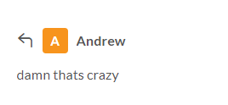

Locust test for the flask App
Simulated test 250 unique users a sec going over 1.5 million requests a month.
Small spike in failures, this is due to some of the pods scaling up and afterwards,
The application faces an increase in response times, this is due to the slower and weaker ec2 instances
A possible solution to fix this would be to increase the number of nodes used and more powerful ec2 instances.
Current infrastructure due to budget constraints that is not possible.

Slide 8
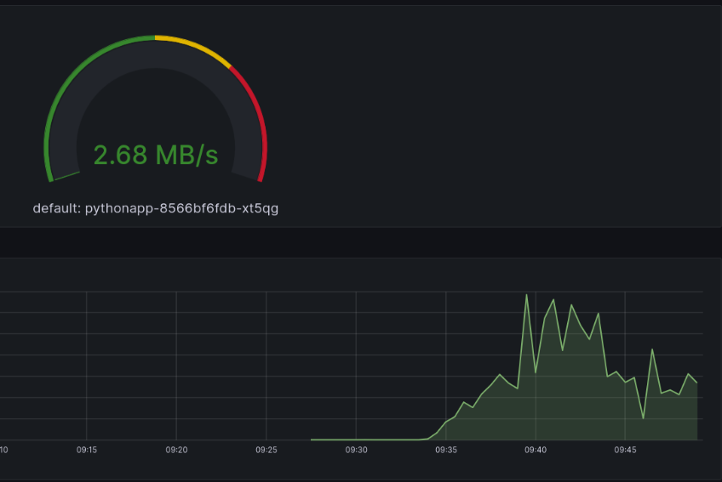
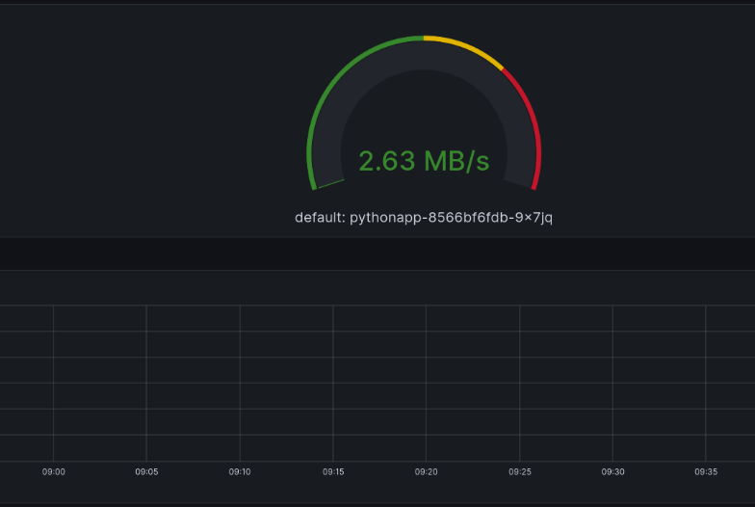
Results

Slide 9
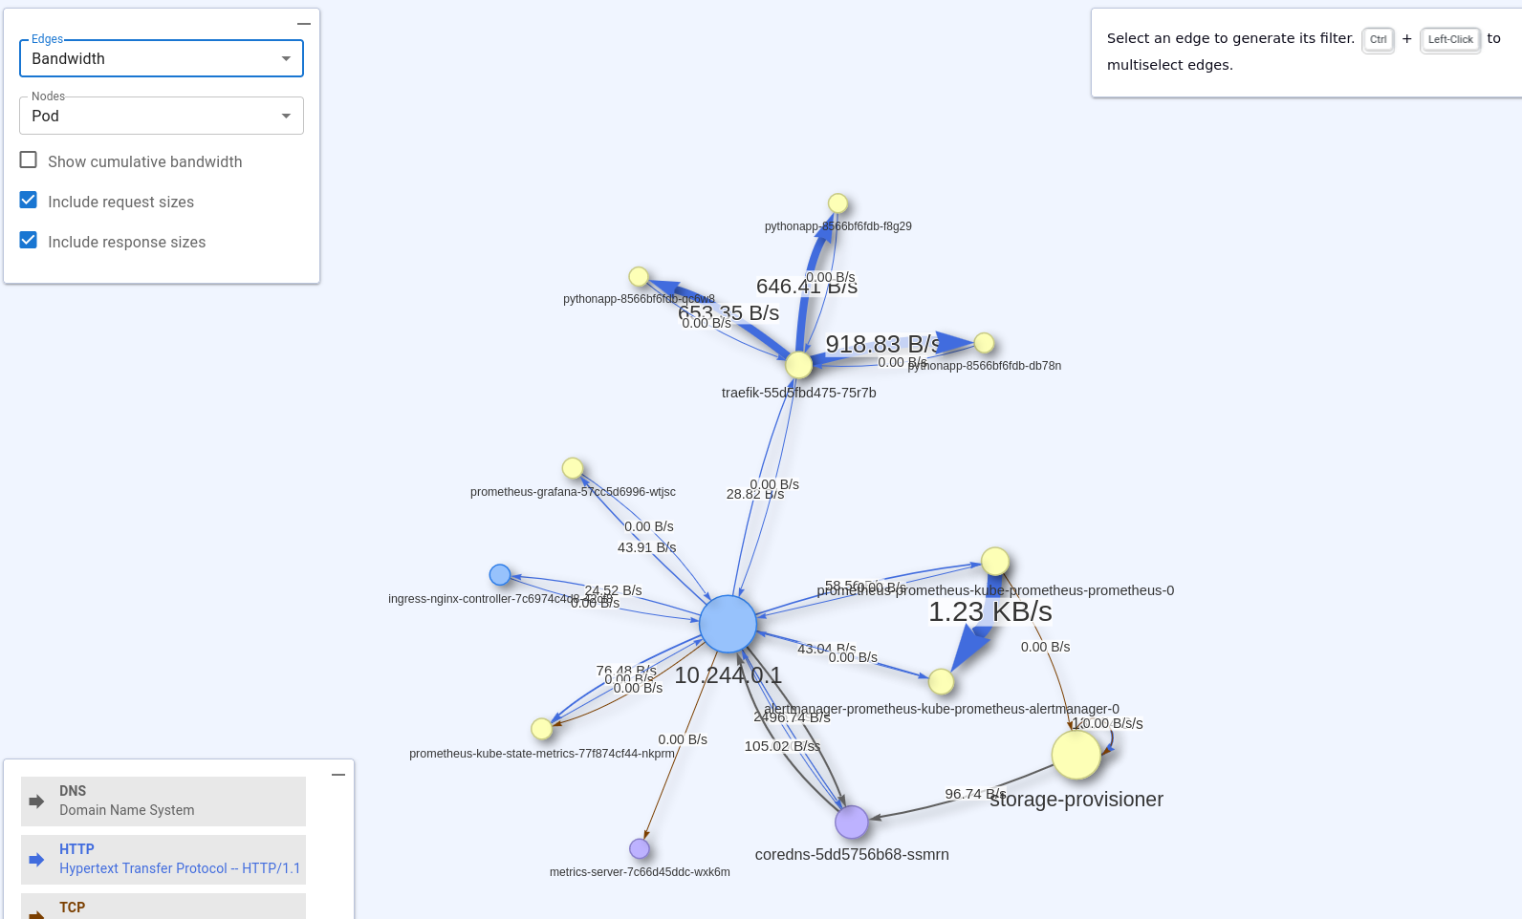

Slide 10

Demo

Slide 11

What went wrong/ What went right
Setting up sticky sessions
In beginning HPA not scaling properly
Communication
Work division
Timely submission

Slide 12

Q&A

